Slide 1
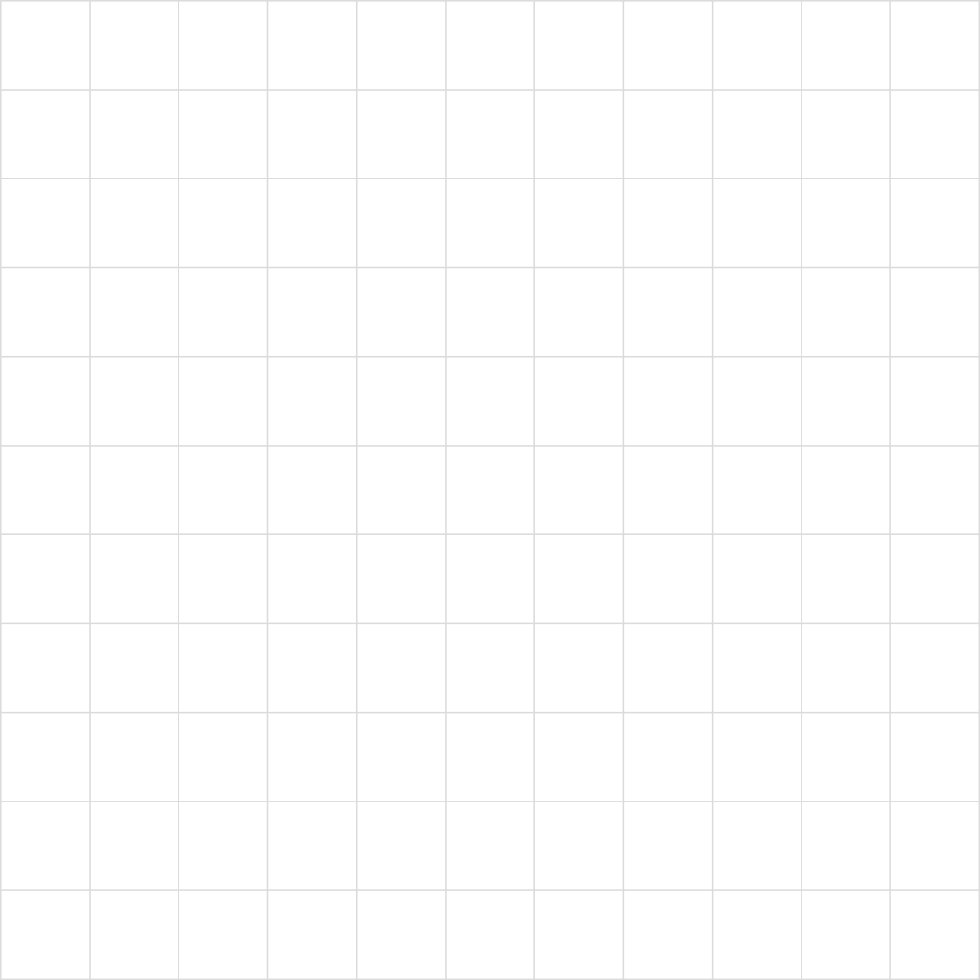

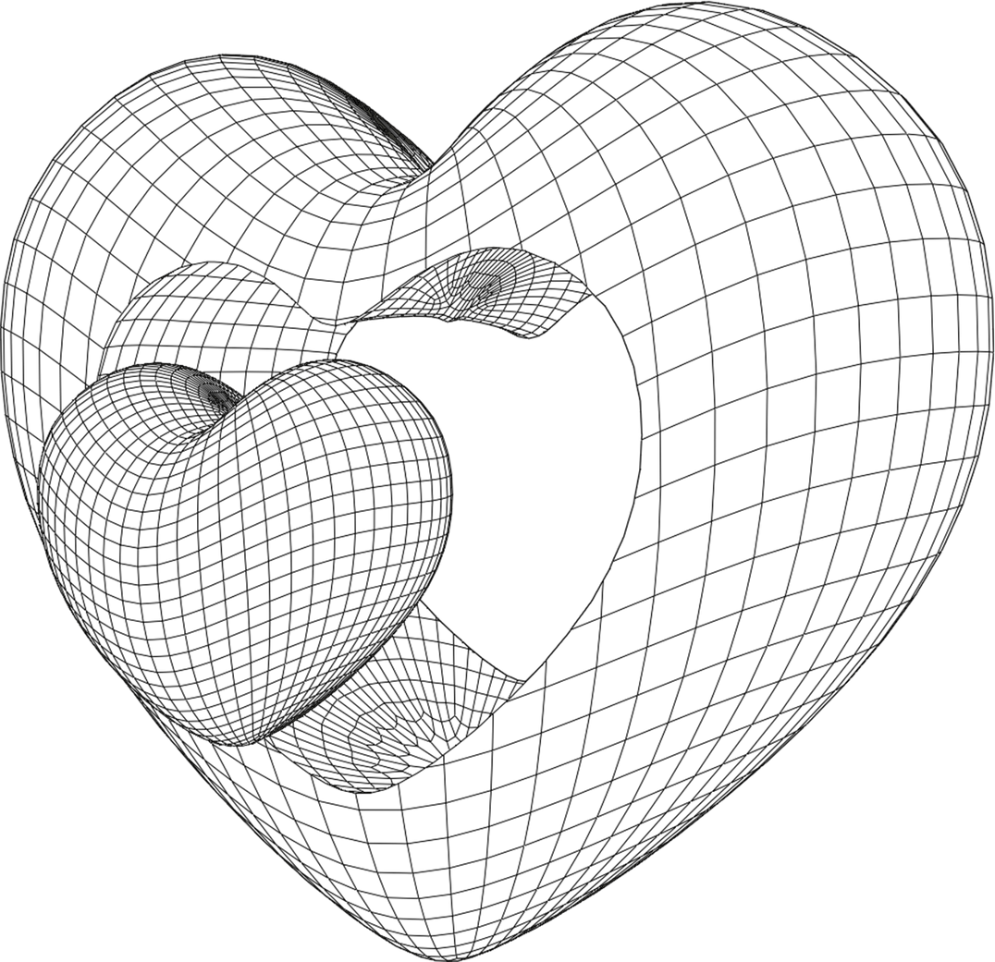
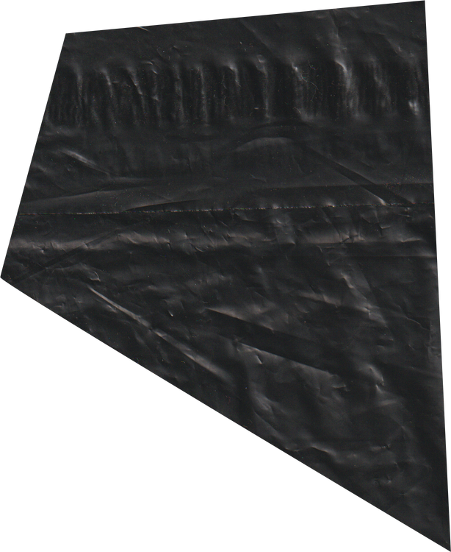

MARCH 2024
AI GROUP
PROJECT
PRESENTATION
ANIMAL SUBSPECIES
MUHAMMAD YUSUF BIN MARZUKI (52213122256)
MUHAMMAD EIRFAN BIN HISHAM (52213122408)

Slide 2
DATA PREPARATION

Slide 3


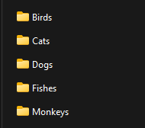

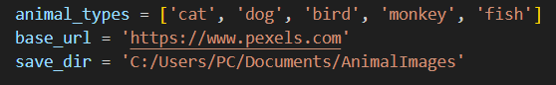
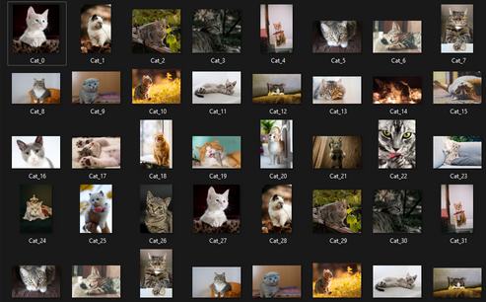
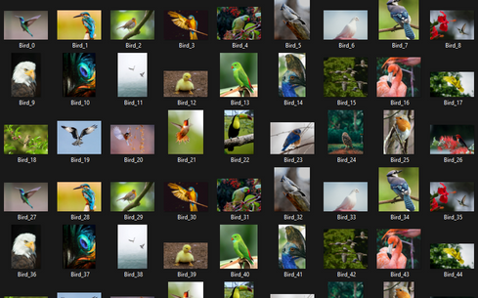
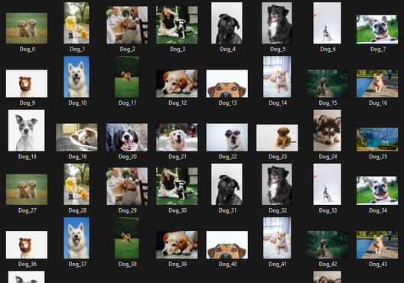
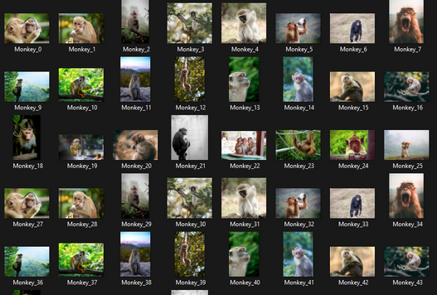
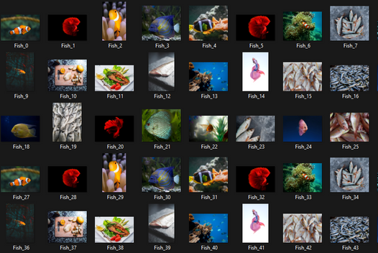

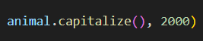
HOW WE COLLECT THE DATA :
1.
2.
3.
CREATE A FOLDER TO STORE ALL THE IMAGE
PROVIDE A LINK FOR THE WEB CRAWLERS TO FINDS ALL THE IMAGE
CREATE A TYPE
TO SEPRATE IMAGE ON EACH ANIMAL TYPE FOLDER
4.
5.
2000 IMAGE BEING STORED IN EACH ANIMAL TYPES
SET DOWNLOAD 2000 IMAGES FOR EACH ANIMAL TYPE

Slide 4
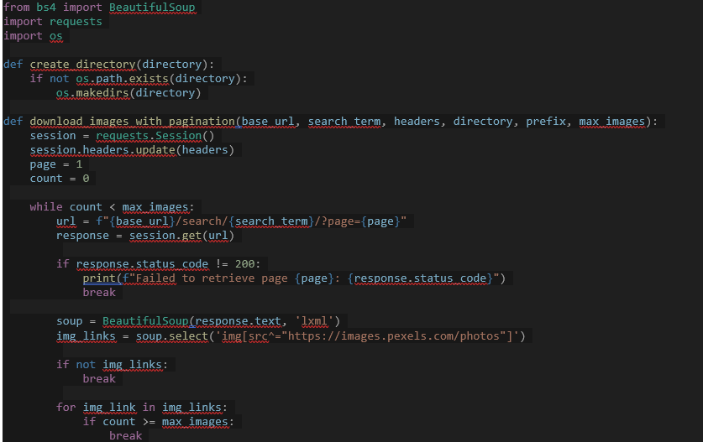
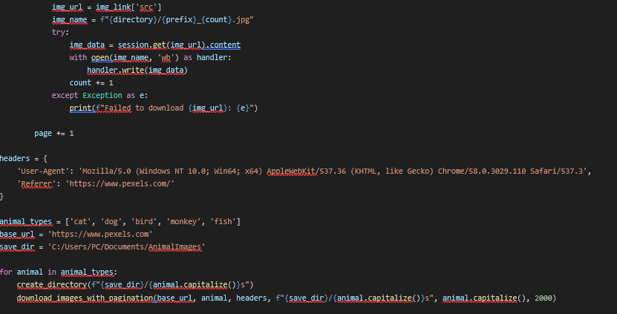
(WEB CRAWLERS CODE)

Slide 5
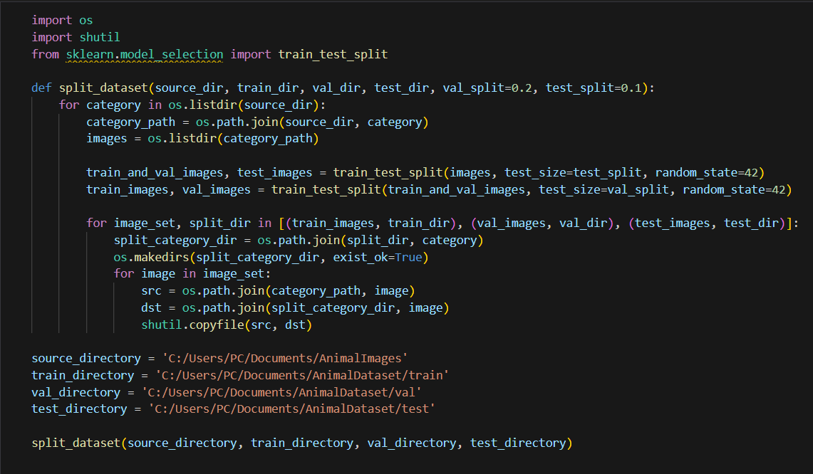
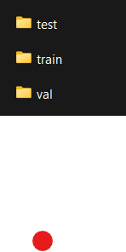

SPLITTING DATASET INTO
TRAINING, VALIDATION AND TESTING
SPLITTING THE IMAGE FOR EACH DATASETS
7200 IMAGES IN TRAINING
1800 IMAGES IN VALIDATION
1000 IMAGES IN TESTING

Slide 6
2. DATA MODELLING
CREATING CNN MODEL (RESNET50, DENSENET121, MOBILENETV3)

Slide 7
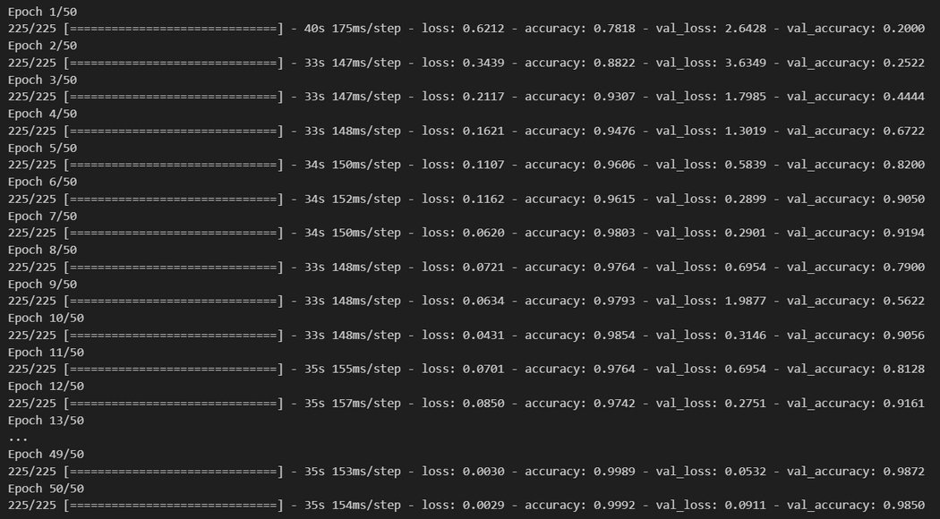
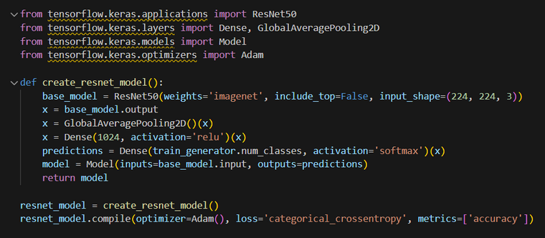
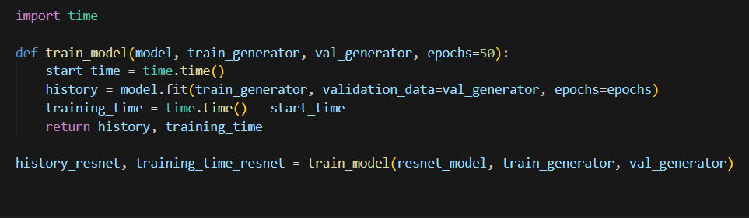
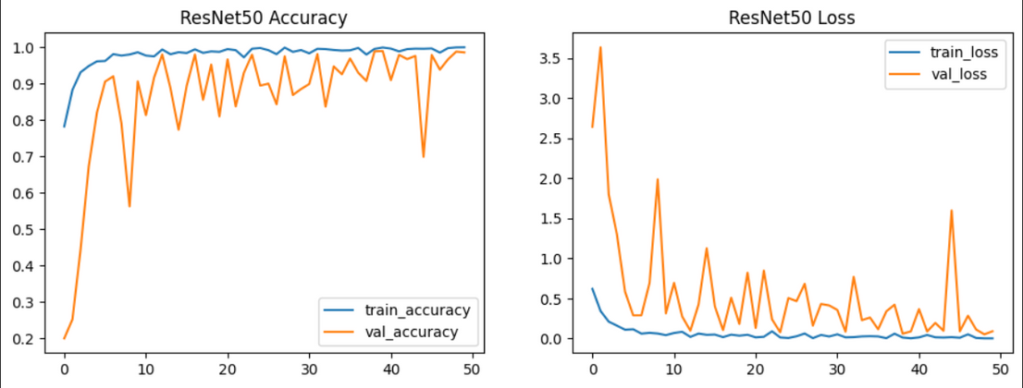
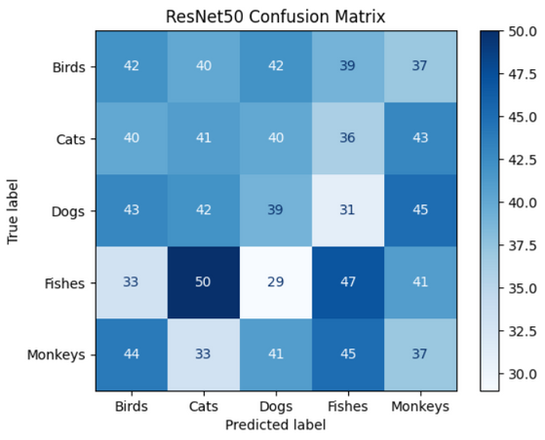
RESNET50
1.
2.
CREATION AND COMPILATION
MODEL
TRAINING:
3.
PERFORMANCE
VISUALIZATION :

Slide 8
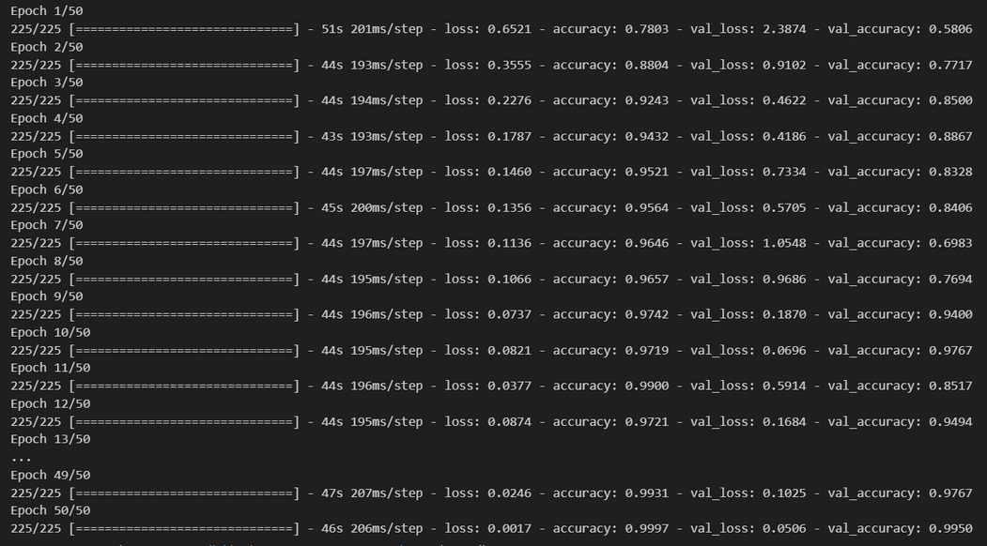
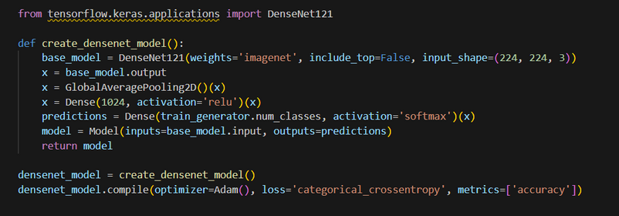
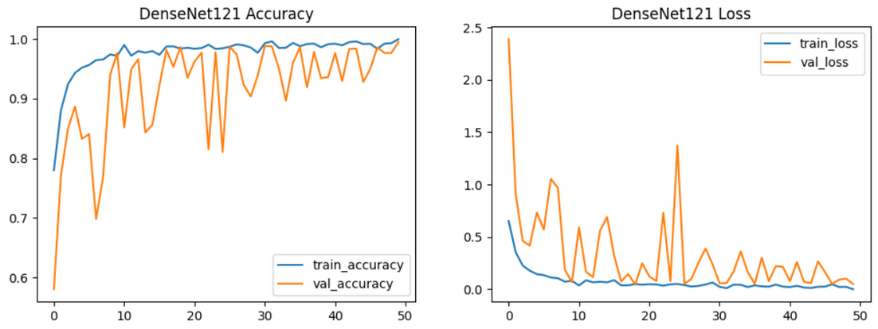
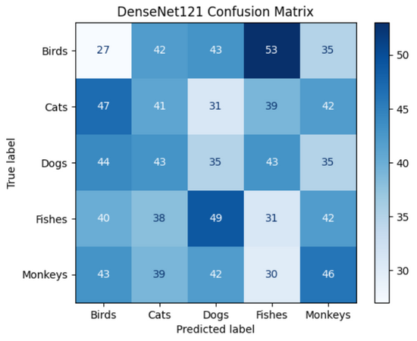
DENSENET121
1.
2.
CREATION AND COMPILATION
MODEL
TRAINING:
3.
PERFORMANCE
VISUALIZATION :

Slide 9
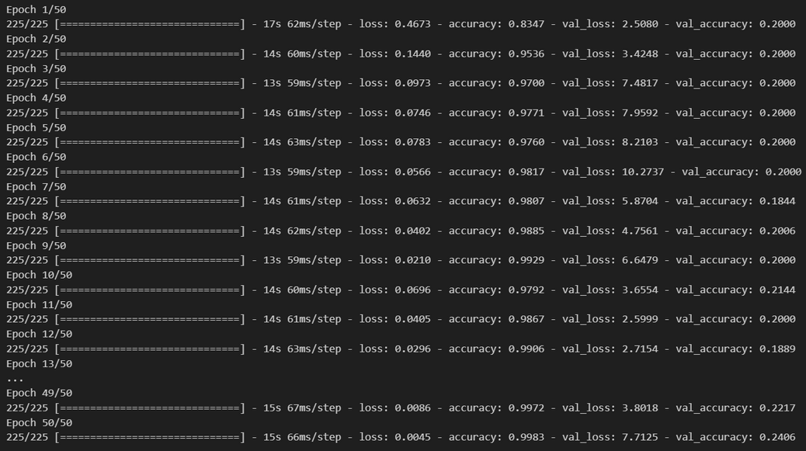
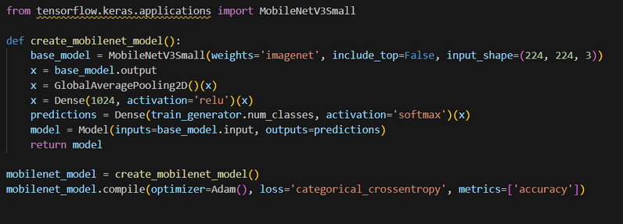
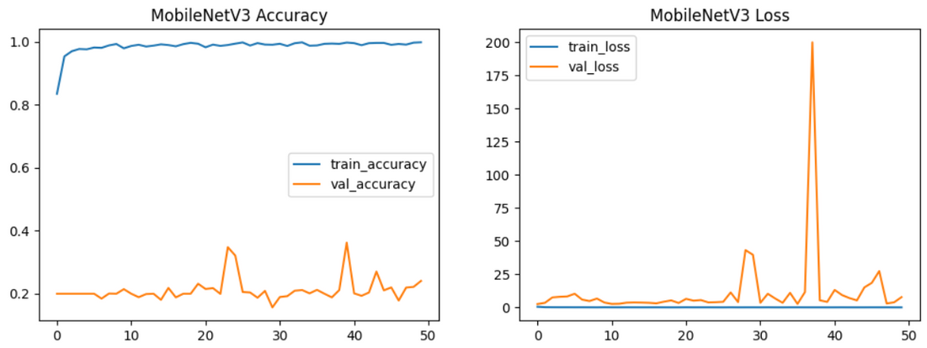
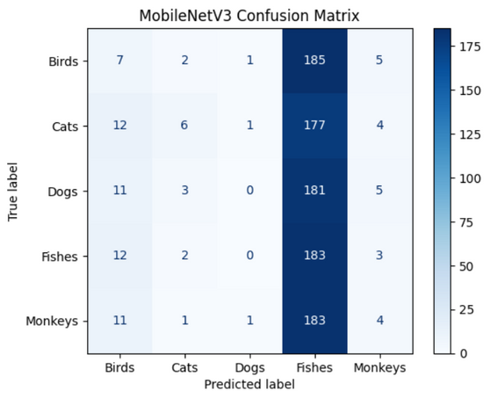
MOBILENETV3
1.
2.
CREATION AND COMPILATION
MODEL
TRAINING:
3.
PERFORMANCE
VISUALIZATION :

Slide 10
3. DATA VISUALIZATION

Slide 11
PERFORMANCE VISUALIZATION OF ALL MODELS:
RESNET50
DENSENET121
MOBILENETV3
ACCURACY:
ACCURACY:
ACCURACY:
LOSS:
LOSS:
LOSS:

Slide 12
CONFUSION MATRIX OF ALL MODELS:
DENSENET121
RESNET50
MOBILENETV3

Slide 13
CONCLUSIONS:
FINAL CONCLUSION:
Considering all the metrics (accuracy, mAP, and training time):
1. Best Model Based on Accuracy: DenseNet121 with Accuracy = 0.9919999837875366
2. Best Model Based on mAP: MobileNetV3 with mAP = 0.20666648265410076
3. Fastest Training Model: MobileNetV3 with Training Time = 751.0900661945343
Recommendation:
- Overall Best Model: DenseNet121. This model has the highest accuracy and mAP, which indicates
it performs the best in terms of correctly classifying images and precision across all classes.
- Best for Fast Training: MobileNetV3. If training time is a critical factor,
MobileNetV3 is the fastest, though it has slightly lower accuracy and mAP compared to DenseNet121 and ResNet50.
- Balanced Choice: ResNet50. It offers a balance between training time and performance,
making it a good middle-ground option if neither extreme of performance nor speed is desired.
DenseNet121 is the recommended model due to its superior accuracy and mAP, which are crucial for reliable classification performance. ​

